Slide 1

Cryptography is the science of using mathematics to encrypt and decrypt data.
Cryptography enables you to store sensitive information or transmit it across insecure networks (like the Internet) so that it cannot be read by anyone except the intended recipient.

Slide 2
What is Cryptography?
The art of secret writing
The art of protection using information
The science of encrypting or hiding secrets
Needed for confidentiality

Slide 3
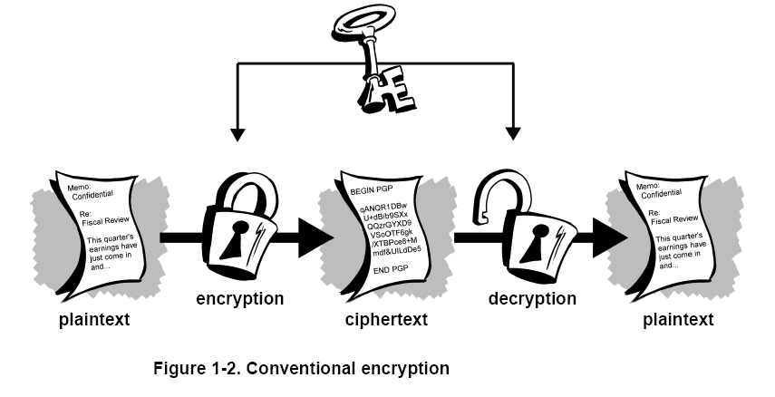

Slide 4
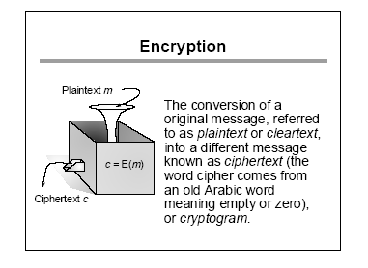

Slide 5
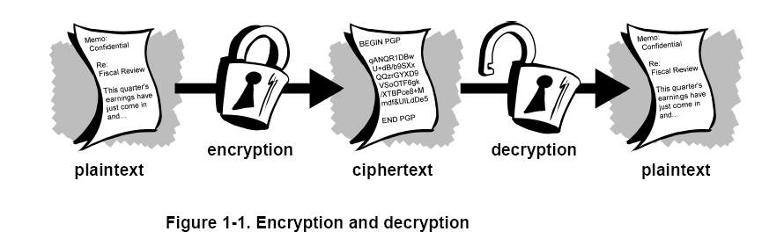

Slide 6
Basic Terminology
plaintext - the original message
ciphertext - the coded message
cipher - algorithm for transforming plaintext to ciphertext
key - info used in cipher known only to sender/receiver
encipher (encrypt) - converting plaintext to ciphertext
decipher (decrypt) - recovering ciphertext from plaintext
cryptography - study of encryption principles/methods
cryptanalysis (codebreaking) - the study of principles/ methods of deciphering ciphertext without knowing key
cryptology - the field of both cryptography and cryptanalysis

Slide 7
Cryptology
CRYPTOLOGY
CRYPTOGRAPHY
CRYPTANALYSIS
Private Key
(Secret Key)
Public Key
Block Cipher
Stream Cipher
Integer Factorization
Discrete Logarithm
Encipher, encrypt
Decipher, decrypt

Slide 8
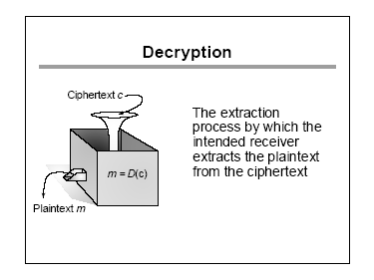

Slide 9
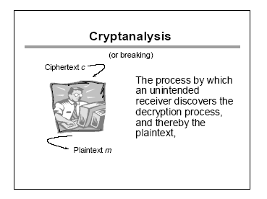

Slide 10
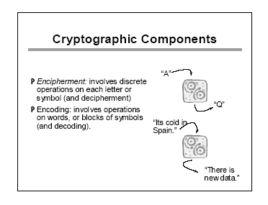

Slide 11
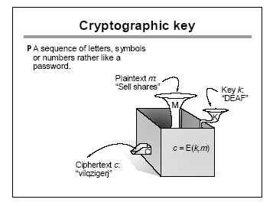

Slide 12
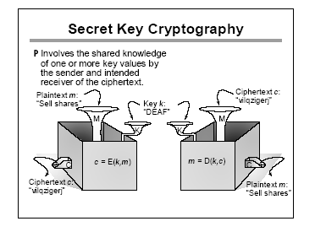

Slide 13
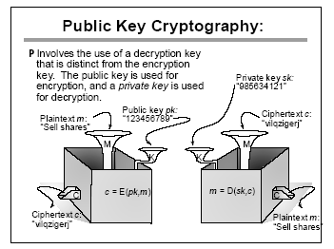

Slide 14
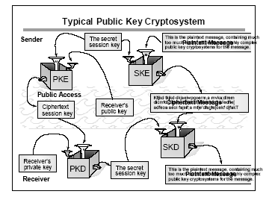

Slide 15
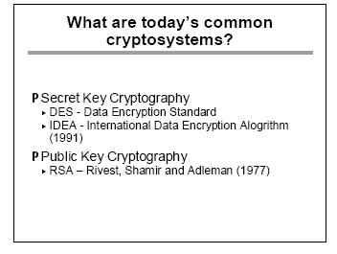

Slide 16
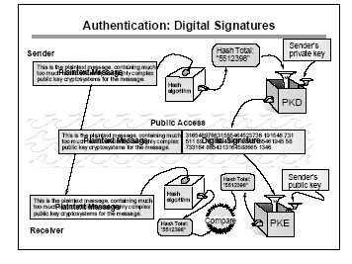

Slide 17
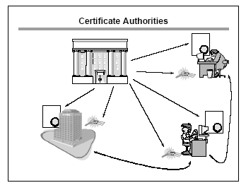

Slide 18
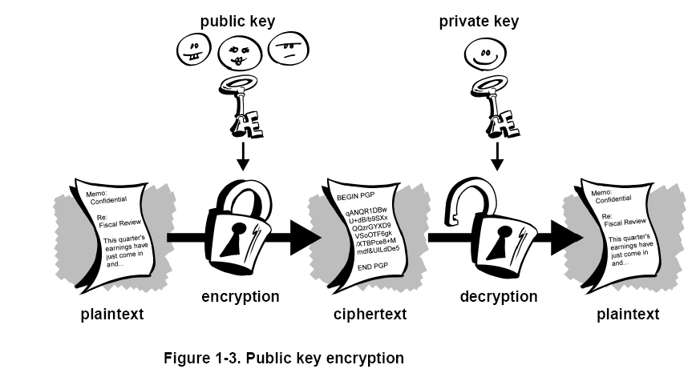

Slide 19
Symmetric Encryption
or conventional / private-key / single-key
sender and recipient share a common key
all classical encryption algorithms are private-key
was only type prior to invention of public-key in 1970’s

Slide 20
Classic ciphers
substitution ciphers
  monoalphabetic ciphers
  polyalphabetic ciphers
transposition (permutation) ciphers
product ciphers
  using both
    substitution, and
    transposition

Slide 21
Classical Cryptography
Monoalphabetic Ciphers
Once a key is chosen, each alphabetic character of a plaintext is mapped onto a unique alphabetic character of a ciphertext.
  The Shift Cipher (Caesar Cipher)
  The Substitution Cipher
  The Affine Cipher

Slide 22
Classical Cryptography
Polyalphabetic Ciphers
Each alphabetic character of a plaintext can be mapped onto m alphabetic characters of a ciphertext. Usually m is related to the encryption key.
  The Vigenère Cipher
  The Hill Cipher
  The Permutation Cipher

Slide 23
Benefits of Cryptography
Offers individual privacy and confidentiality.
In some circumstances also authentication and non-repudiation (e.g. legal ‘signatures’)
Especially important in explicitly Authorization .

Slide 24
4 types of cryptanalysis
depending on what a cryptanalyst has to work with, attacks can be classified into
  ciphertext only attack
  known plaintext attack
  chosen plaintext attack
  chosen ciphertext attack (most severe)

Slide 25
4 types of attacks (2)
ciphertext only attack
  the only data available is a target ciphertext
known plaintext attack
  a target ciphertext
  pairs of other ciphertext and plaintext (say, previously broken)

Slide 26
4 types of attacks (3)
chosen plaintext attacks
  a target ciphertext
  can feed encryption algorithm with plaintexts and obtain the matching ciphertexts
chosen ciphertext attack
  a target ciphertext
  can feed decryption algorithm with ciphertexts and obtain the matching plaintexts

Slide 27
The Caesar cipher
The Caesar cipher is a substitution cipher, named after Julius Caesar.
Operation principle:
each letter is translated into the letter a fixed number of positions after it in the alphabet table.
the fixed number of positions is a key both for encryption and decryption.

Slide 28
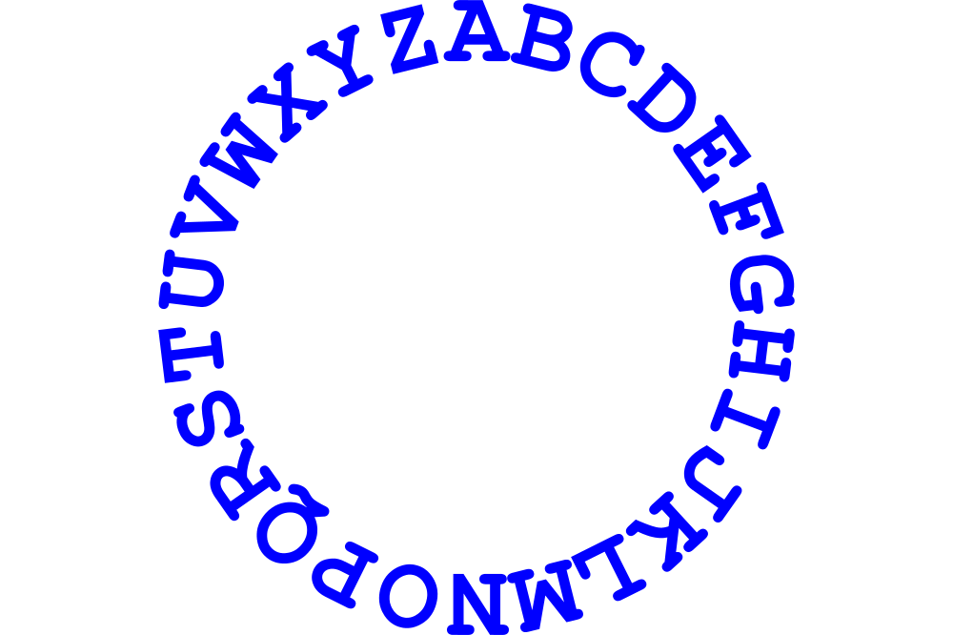
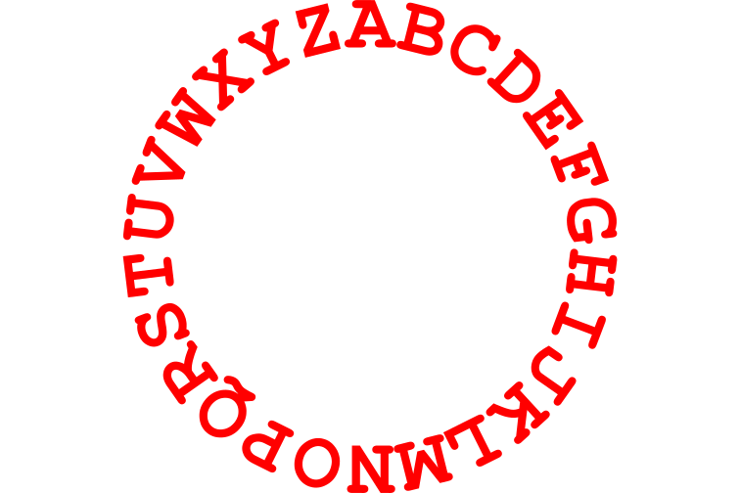
The Caesar cipher (cnt’d)
Outer: plaintext
Inner: ciphertext

Slide 29
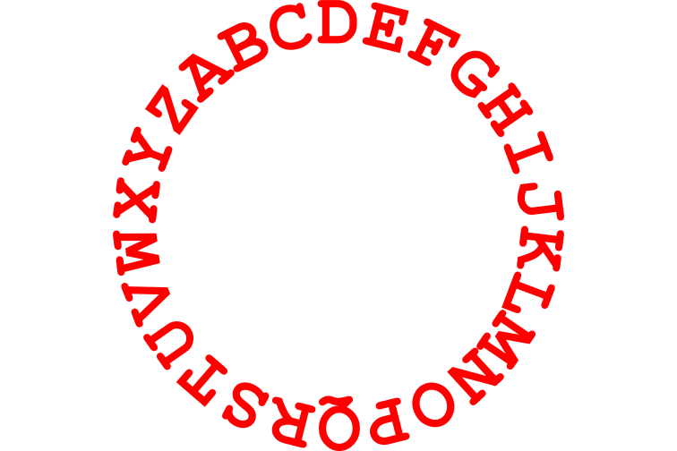
The Caesar cipher (cnt’d)
K=3

Slide 30
The Caesar cipher (cnt’d)
K=3

Slide 31
Caesar Cipher
The Caesar cipher is still useful as a way to prevent people from unintentionally reading something.
  ROT-13
  By decrypting, the user agrees that they want to view the content.
Fundamental problem: key length is shorter than the message.
Let P = C = K = Z₂₆.
∀x∈P, ∀y∈C, ∀K∈K, define
y =e_{K}(x) = x + K (mod 26)
and
X=d_{K}(y) = y - K (mod 26).

Slide 32
An example
for a key K=3,
plaintext letter: ABCDEF...UVWXYZ
ciphtertext letter: DEF...UVWXYZABC
Hence
TREATY IMPOSSIBLE
is translated into
WUHDWB LPSRVVLEOH

Slide 33
Breaking the Caesar cipher
by trial-and error
by using statistics on letters
  frequency distributions of letters
  letter percent
  A 7.49%
  B 1.29%
  C 3.54%
  D 3.62%
  E 14.00%
  ..................................

Slide 34
Shift cipher
Two basic properties for a cryptosystem:
1. Each encryption function e_{K} and each decryption d_{K} should be
efficiently computable.
2. An opponent upon seeing a ciphertext string y, should be unable to
determine the key K that was used, or the plaintext string x.
Question: is shift cipher secure?
Of course NOT, since there are only 26 possible keys,
it is easy to be broken by exhaustive key search.
Example: JBCRCLQRWCRVNBJENBWRWN
Plaintext: astitchintimesavesnine (K=9)
On average, a plaintext will be computed after trying 26/2=13 times.

Slide 35
Substitution Ciphers
Symbols are replaced by other symbols according to a key.
  Caesar cipher is a substitution cipher.
To escape frequency analysis, we can use a homophonic substitution cipher
  Map symbols to multiple symbols.
  e.g 0 -> {01, 10}, 1->{00,11}
  Advantage: frequencies hidden
  Disadvantage: message and key are longer
  Substitution is said to add confusion
    Measure of the relationship between plaintext and ciphertext
0 | 1 | 1 | 0 | 1 | 0 | 0 | 1 | 0
01 | 11 | 00 | 10 | 11 | 01 | 01 | 11 | 10

Slide 36
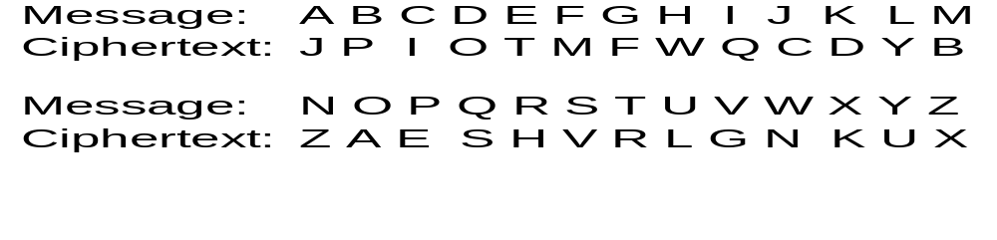
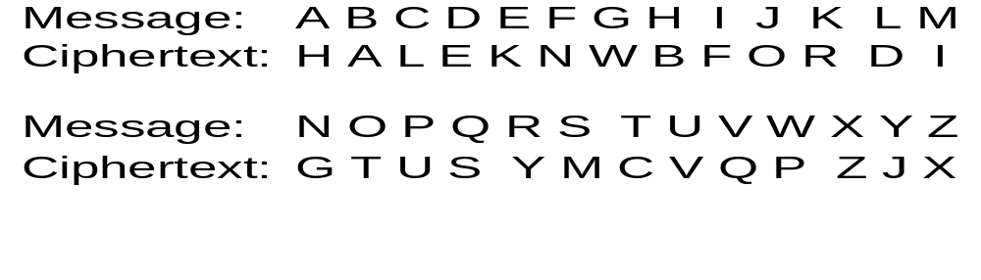
Substitution cipher

Slide 37
Substitution Cipher
For each letter, substitute some other letter(randomly)
  A key determines what the substitution is
  E.g., 4, 8, 1, 26,...
    1st letter in the alphabet will be represented by the 4th letter
    A → D
    2nd letter will be represented by the 8th
    B → H
    3rd letter will be represented by the 1st
    C → A
    4th letter will be represented by the 26th
    D → Z

Slide 38
Substitution cipher—formal definition
Let P = C = Z₂₆ , K, consists of all possible permutations of the 26 symbols 0,1, …, 25 ( or a,b,…,z). For each permutation π ∈K, , define
    e_{π}(x) = π(x)
and
    d_{π}(y) = π⁻¹(y)
      (π⁻¹ is the inverse permutation of π )
Given plaintext: cryptography
  The ciphertext: YCDLMFOCXLGD
Given ciphertext: MGZVYZLGHCMHJMYXSSFMNHAHYCDLMHA

Slide 39
Substitution cipher
Question: what is the key space?
A key is a permutation of 26 letters, so 26! permutations, i.e.,
more than 4.0 × 1026 . Thus exhaustive key search is infeasible.
Question: what is the relationship between shift and substitution cipher?
However, using frequency analysis, substitution cipher is easily broken.
Shift cipher is a special case of substitution cipher which includes
only 26 of 26! possible permutations.

Slide 40
Classical Cipher
Monalphabits
Polyalphabetis
Symmetric Vs. Asymmetric
Private Vs, Public
Substitution Vs. Transposition
Stream Vs. Block

Slide 41
Substitution
Caesar (shift)
Other substitutions
One-Time Pad
Vigenere Tableau
Long Random Number Sequences
Vernam Cipher

Slide 42
One-Time Pads
Called the Perfect Key
Large number of nonrepeating keys are used
Use Vigenere Tableau
Problems:
  Absolute Synchronization between Sender and Receiver
  Need for an Unlimited Number of Keys

Slide 43
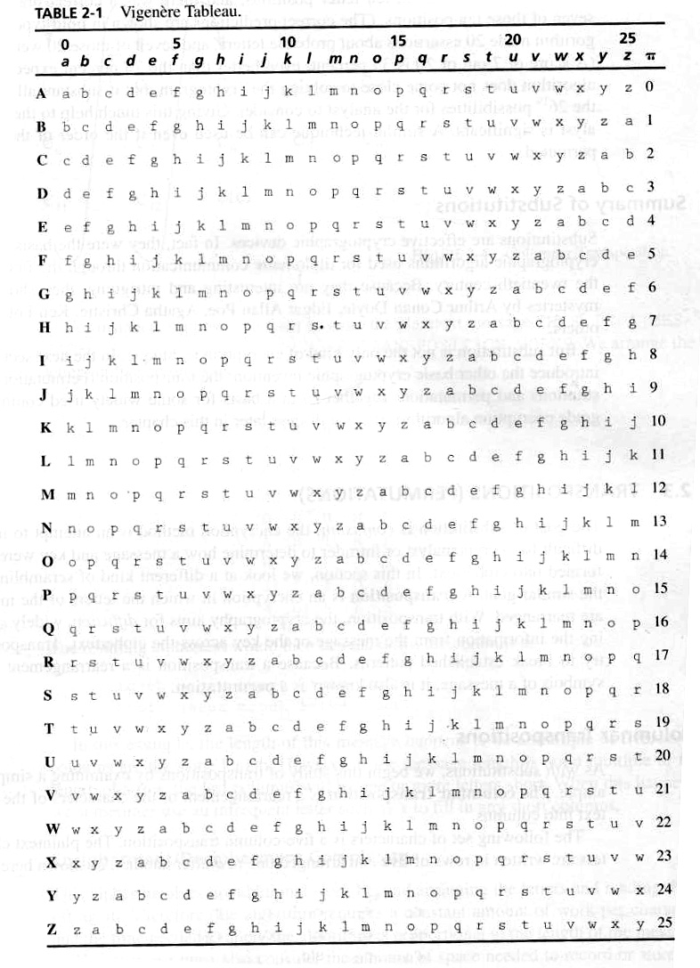

Slide 44
Long Random Number Sequences
Vernam Cipher
A one-time Pad Cipher
Use Numbers Mod 26 to represent Letters
Use A two-digit Random Numbers
Add the two numbers and take Mod 26

Slide 45
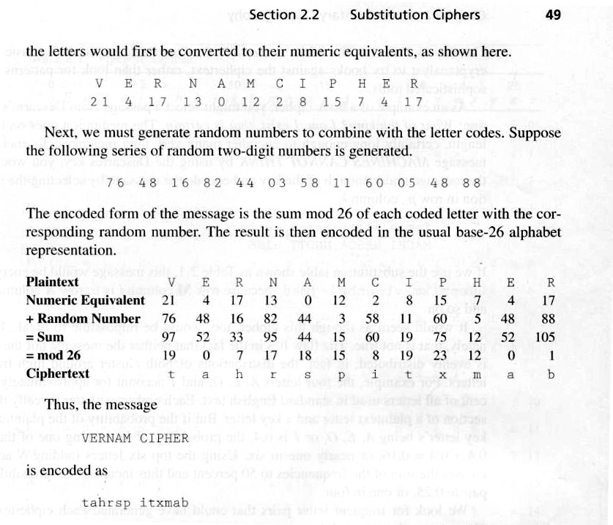
Vernam Cipher Example

Slide 46
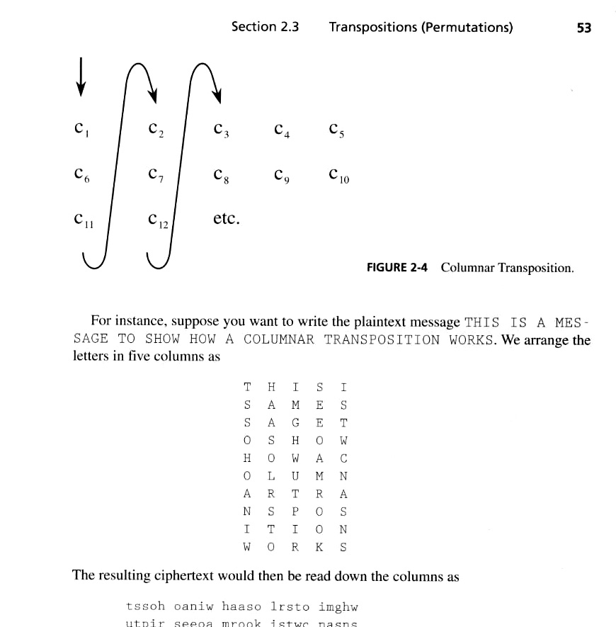
Transpositions (Permutations)
Rearrangement of Symbols in a message

Slide 47
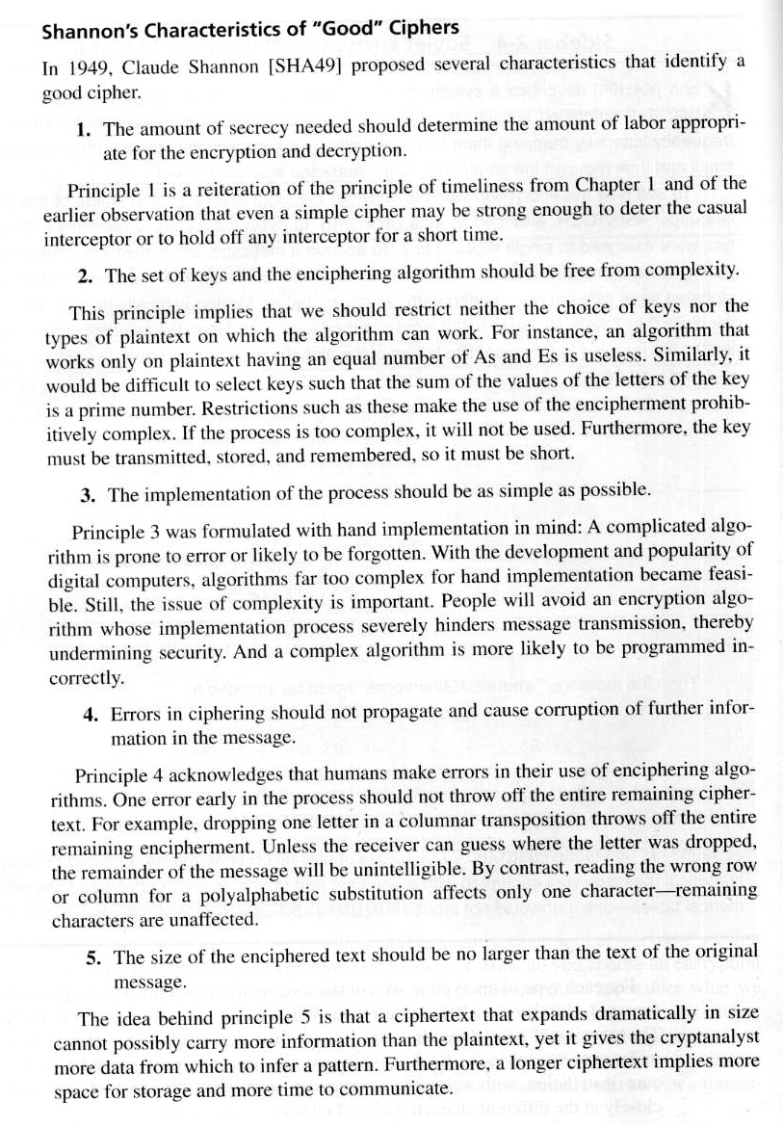
What Makes a Good Cipher (Shannon’s)

Slide 48
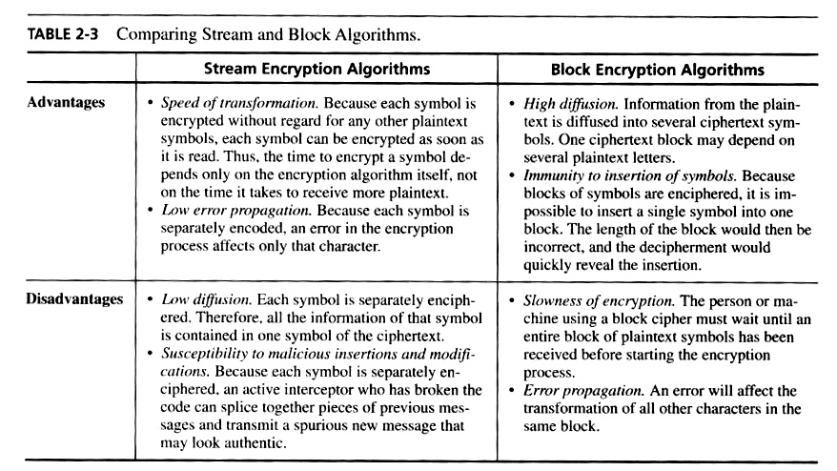
Stream Vs. Block

Slide 49
DES
Data Encryption Standard (NBS77)
Adopted by US Fedral Standards in 1977

Slide 50
DES (overview)
Symmetric Algorithm
Block Cipher
Uses a combination of Substitution and Transpositions (permutations)
Called a Product Cipher
Goes through 16 cycles
PlainText is organized into 64-bit Blocks
Uses a 56-bit Key

Slide 51
DES (overview)
Initial Permutation on Input Text (64-bit)
Split into Right and Left Halves (32-bit)
Take right half and permute it (Expansion Permutation) 48-bit
Work on Key (shift) 56-bit, then permute key (48-bits)
XOR resulting key with right half …result is 32-bit (S-BoX)
Permute result
XOR result with Left Half
End of Cycle

Slide 52
DES (cont.)
The next cycle begins with:
  The result of previous cycle as its right half
  The old Right half (48-bit) as Its left half
  Repeat

Slide 53
Key Transformation
Starts with 64-bit
Drop every eighth bit = 56 bits
Split into two 28-bits halves
Shift each key to the lift (number of bits)
Paste both halves
48-bit key is then permuted

Slide 54
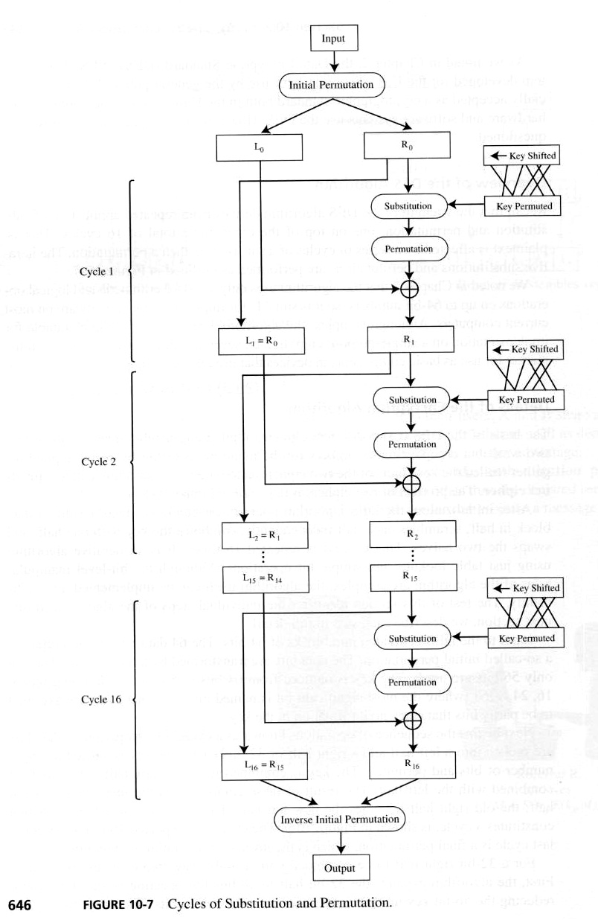

Slide 55
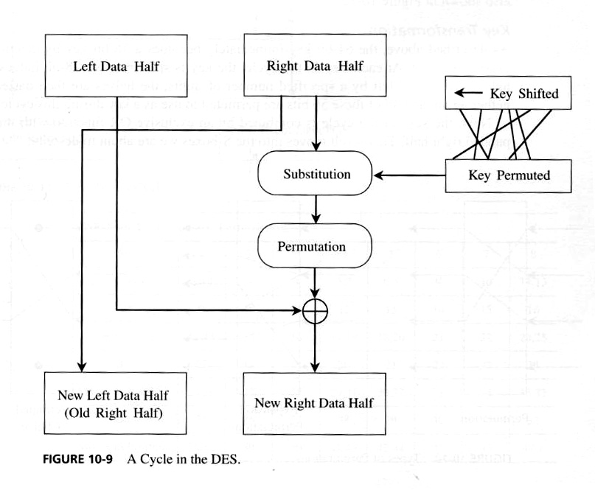

Slide 56
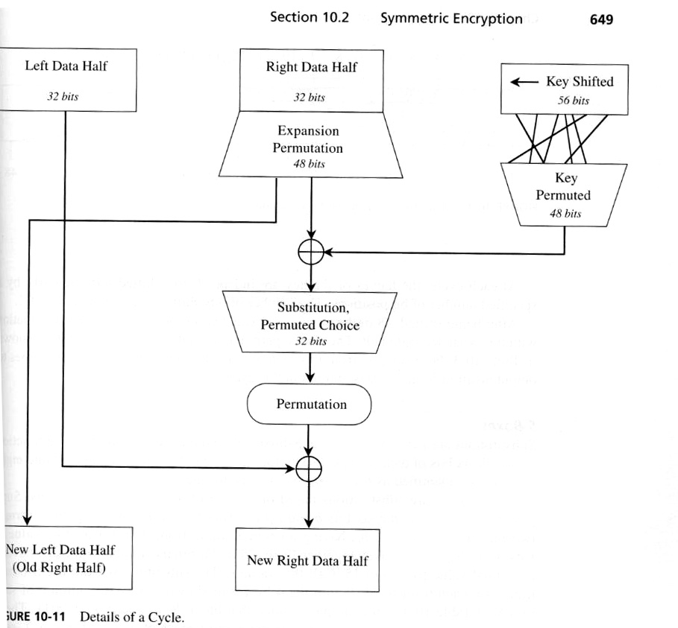

Slide 57
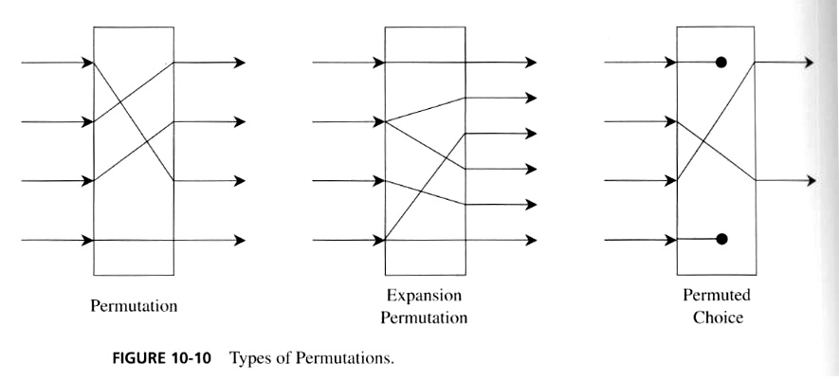
Types of Permutations

Slide 58
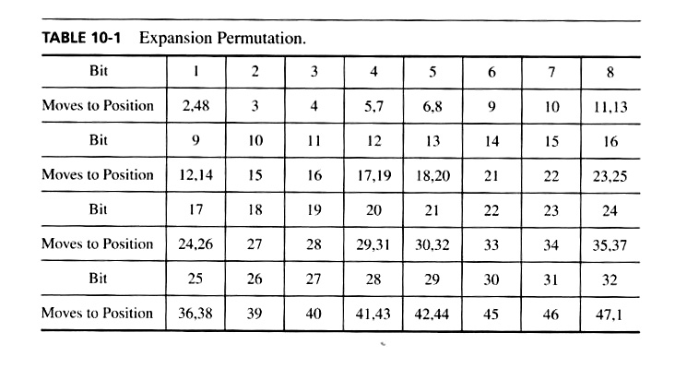
Expansion Permutation in DES

Slide 59
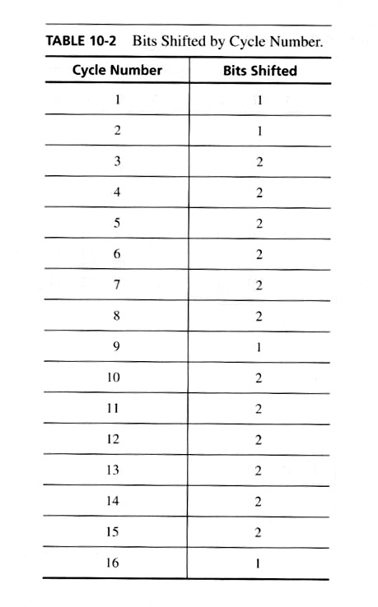

Slide 60
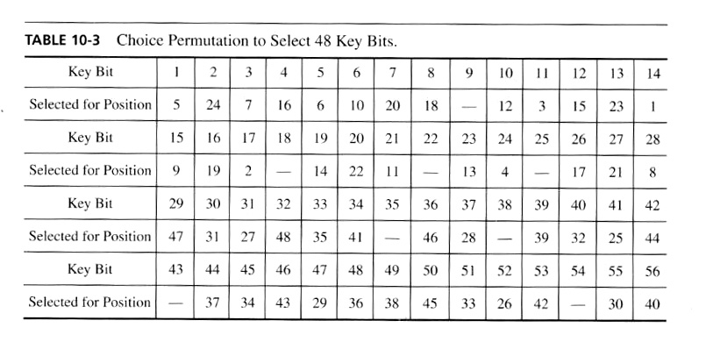

Slide 61
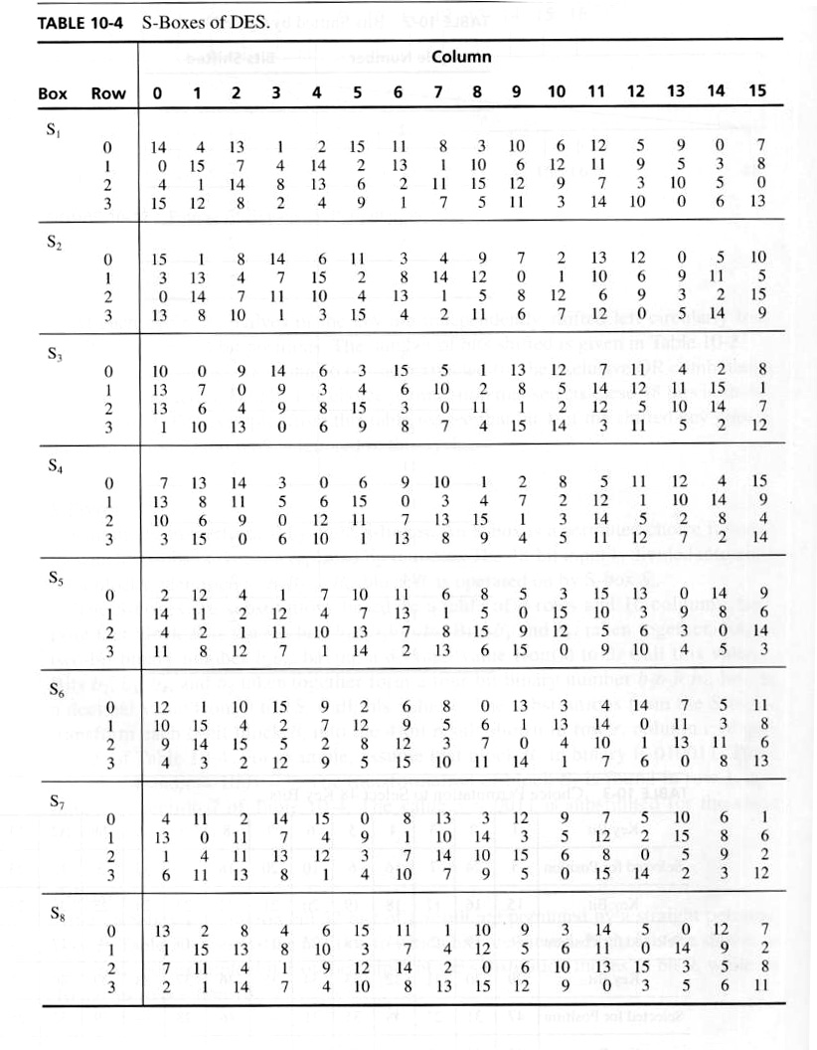

Slide 62
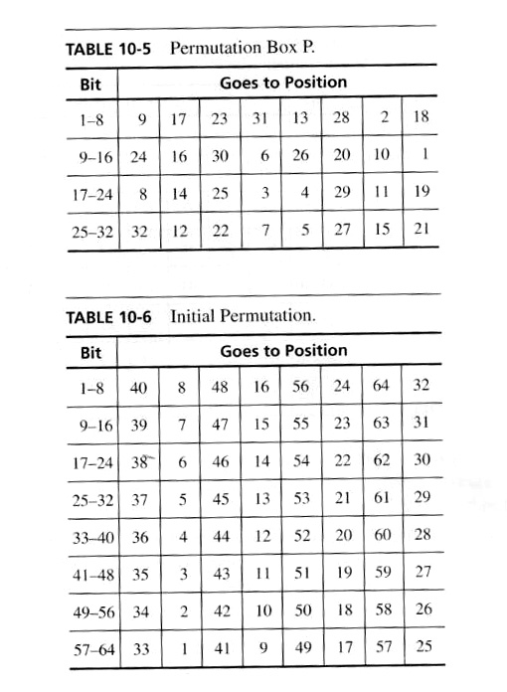

Slide 63
Advanced Encryption Standard
AES
"It seems very simple."
"It is very simple. But if you don't know what the key is it's virtually indecipherable."
—Talking to Strange Men, Ruth Rendell

Slide 64
Origins
clear a replacement for DES was needed
  have theoretical attacks that can break it
  have demonstrated exhaustive key search attacks
can use Triple-DES – but slow with small blocks
US NIST issued call for ciphers in 1997
15 candidates accepted in Jun 98
5 were short-listed in Aug-99
Rijndael was selected as the AES in Oct-2000
issued as FIPS PUB 197 standard in Nov-2001
Notes:
The AES candidates are the latest generation of block ciphers, and now we see a significant increase in the block size - from the old standard of 64-bits up to 128-bits; and keys from 128 to 256-bits. In part this has been driven by the public demonstrations of exhaustive key searches of DES. Whilst triple-DES is regarded as secure and well understood, it is slow, especially in s/w.

Slide 65
AES Requirements
private key symmetric block cipher
128-bit data, 128/192/256-bit keys
stronger & faster than Triple-DES
active life of 20-30 years (+ archival use)
provide full specification & design details
both C & Java implementations
NIST have released all submissions & unclassified analyses

Slide 66
AES Evaluation Criteria
initial criteria:
  security – effort to practically cryptanalyse
  cost – computational
  algorithm & implementation characteristics
final criteria
  general security
  software & hardware implementation ease
  implementation attacks
  flexibility (in en/decrypt, keying, other factors)
Notes:
Initial criteria were issued with call, and used to evaluate field of 15 candidates to select shortlist of 5.
The final criteria were used to select Rijndael from that short-list.

Slide 67
AES Shortlist
after testing and evaluation, shortlist in Aug-99:
  MARS (IBM) - complex, fast, high security margin
  RC6 (USA) - v. simple, v. fast, low security margin
  Rijndael (Belgium) - clean, fast, good security margin
  Serpent (Euro) - slow, clean, v. high security margin
  Twofish (USA) - complex, v. fast, high security margin
then subject to further analysis & comment
saw contrast between algorithms with
  few complex rounds verses many simple rounds
  which refined existing ciphers verses new proposals
Notes:
The shortlist is as shown. Note mix of commercial (MARS, RC6, Twofish) verses academic (Rijndael, Serpent) proposals, sourced from various countries.
All were thought to be good – came down to best balance of attributes to meet criteria.

Slide 68
The AES Cipher - Rijndael
designed by Rijmen-Daemen in Belgium
has 128/192/256 bit keys, 128 bit data
an iterative rather than feistel cipher
  treats data in 4 groups of 4 bytes
  operates an entire block in every round
designed to be:
  resistant against known attacks
  speed and code compactness on many CPUs
  design simplicity
Notes:
Rijndael is an academic submission, based on the earlier Square cipher, from Belgium academics Dr Joan Daemen and Dr Vincent Rijmen.
It is an iterative cipher (operates on entire data block in every round) rather than feistel (operate on halves at a time). cf IDEA cipher

Slide 69
Rijndael
processes data as 4 groups of 4 bytes (state)
has 9/11/13 rounds in which state undergoes:
  byte substitution (1 S-box used on every byte)
  shift rows (permute bytes between groups/columns)
  mix columns (subs using matrix multiply of groups)
  add round key (XOR state with key material)
initial XOR key material & incomplete last round
all operations can be combined into XOR and table lookups - hence very fast & efficient
Notes:
Data is written into the state matrix by columns; this matrix is manipulated at stage of the en/decryption process, and is then finally copied to the output.
The key is expanded into 44/52/60 lots of 32-bit words (see later), with 4 used in each round.
The data computation then consists of an “add round key” step, then 9/11/13 rounds with all 4 steps, and a final 10th/12th/14th step of byte subs + mix cols + add round key. All steps are easily reversed.
Note only the “add round key” step makes use of the key and obscures the result, hence MUST be used at start and end of each round, since otherwise could undo effect of other steps. But the other steps provide confusion/diffusion/non-linearity. ie can look at cipher as a series of XOR with key then scramble/permute block repeated. This is efficient and highly secure it is believed.

Slide 70
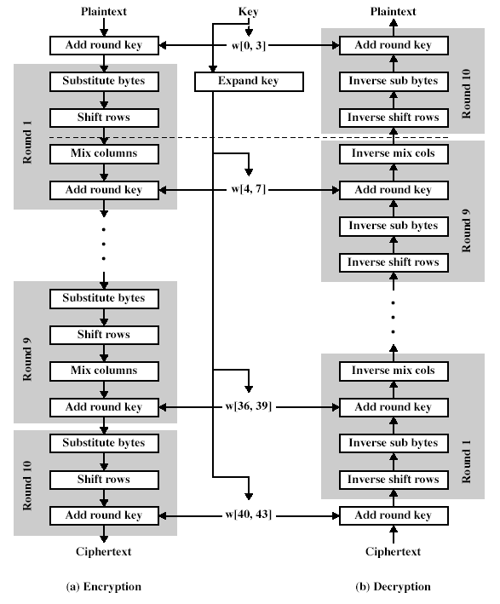
Rijndael
Notes:
Stallings Fig 5-1.

Slide 71
Byte Substitution
a simple substitution of each byte
uses one table of 16x16 bytes containing a permutation of all 256 8-bit values
each byte of state is replaced by byte in row (left 4-bits) & column (right 4-bits)
  eg. byte {95} is replaced by row 9 col 5 byte
  which is the value {2A}
S-box is constructed using a defined transformation of the values in GF(2⁸)
designed to be resistant to all known attacks
Notes:
There is a single 8-bit wide S-box used on every byte. This S-box is a permutation of all 256 8-bit values, constructed using a transformation which treats the values as polynomials in GF(2⁸) – however it is fixed, so really only need to know the table when implementing. Decryption requires the inverse of the table.

Slide 72
Shift Rows
a circular byte shift in each row
  1st row is unchanged
  2nd row does 1 byte circular shift to left
  3rd row does 2 byte circular shift to left
  4th row does 3 byte circular shift to left
decrypt does shifts to right
since state is processed by columns, this step permutes bytes between the columns
Notes:
This step provides “permutation” of the data, whereas the other steps involve substitutions.

Slide 73

Mix Columns
each column is processed separately
each byte is replaced by a value dependent on all 4 bytes in the column
effectively a matrix multiplication in GF(2⁸) using prime poly m(x) =x⁸+x⁴+x³+x+1
Notes:
This step is also a substitution, but one involving ALL values in a column. Designed as a matrix multiplication where each byte is treated as a polynomial in GF(2⁸). The inverse used for decryption involves a different set of constants.
The constants used are based on a linear code with maximal distance between code words – this gives good mixing of the bytes within each column. Combined with the “shift rows” step provides good avalanche, so that within a few rounds, all output bits depend on all input bits.

Slide 74
Add Round Key
XOR state with 128-bits of the round key
again processed by column (though effectively a series of byte operations)
inverse for decryption is identical since XOR is own inverse, just with correct round key
designed to be as simple as possible

Slide 75
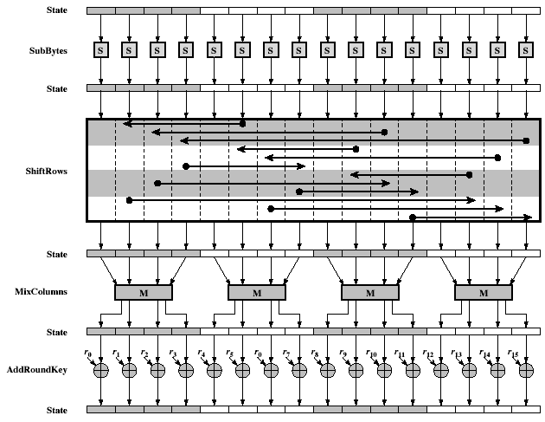
AES Round
Notes:
Stallings Fig 5-3.

Slide 76
AES Key Expansion
takes 128-bit (16-byte) key and expands into array of 44/52/60 32-bit words
start by copying key into first 4 words
then loop creating words that depend on values in previous & 4 places back
  in 3 of 4 cases just XOR these together
  every 4th has S-box + rotate + XOR constant of previous before XOR together
designed to resist known attacks
Notes:
Key expansion is designed to be simple to implement, but by using round constants break symmetries, and make it much harder to deduce other key bits if just some are known (but once have as many consecutive bits as are in key, can then easily recreate the full expansion).

Slide 77
AES Decryption
AES decryption is not identical to encryption since steps done in reverse
but can define an equivalent inverse cipher with steps as for encryption
  but using inverses of each step
  with a different key schedule
works since result is unchanged when
  swap byte substitution & shift rows
  swap mix columns & add (tweaked) round key
Notes:
By constructing an equivalent inverse cipher with steps in same order as for encryption, can derive a more efficient implementation. Clearly swapping the byte substitutions and shift rows has no effect, since work just on bytes. Swapping the mix columns and add round key steps requires the inverse mix columns step be applied to the round keys first – this makes the decryption schedule a little more complex with this construction.

Slide 78
Implementation Aspects
can efficiently implement on 8-bit CPU
  byte substitution works on bytes using a table of 256 entries
  shift rows is simple byte shifting
  add round key works on byte XORs
  mix columns requires matrix multiply in GF(2⁸) which works on byte values, can be simplified to use a table lookup

Slide 79
Implementation Aspects
can efficiently implement on 32-bit CPU
  redefine steps to use 32-bit words
  can pre-compute 4 tables of 256-words
  then each column in each round can be computed using 4 table lookups + 4 XORs
  at a cost of 16Kb to store tables
designers believe this very efficient implementation was a key factor in its selection as the AES cipher

Slide 80
Summary
have considered:
  the AES selection process
  the details of Rijndael – the AES cipher
  looked at the steps in each round
  the key expansion
  implementation aspects

Slide 81
Public Key Cryptosystems & Digital Signatures
Notes:
Last lecture we saw the data encryption standard. However this require that the secret keys need to be exchanged between the parties and a number of pairs of such keys has to be maintained by each user (How many are they if you communicate with n different people and there are m such people in the population and assume n <m).
We want to look at another method which avoids knowing that many no of keys

Slide 82
Outline
Why public key cryptography ?
general principles of public key cryptography
the RSA public key cryptosystem
examples of RSA
Notes:
We will discuss in this lecture why we need public key cryptography, how it works and an example of a system

Slide 83
Private key cipher
Encryption
Encrypted message
(ciphertext)
Decryption
Encrypted message
(ciphertext)
E
Alice
D
Bob
key
Message
(cleartext,plaintext)
Message
(cleartext, plaintext)

Slide 84
Problems with private key ciphers
In order for Alice & Bob to be able to communicate securely using a private key cipher, such as DES, they have to have a shared key in the first place.
  Question:
  What if they have never met before ?
Alice needs to keep 100 different keys if she wishes to communicate with 100 different people
Notes:
The major problem with the private key encryption technique is how securely you can exchange the key over the network without being evedropped.
Also how many such keys you need to remember if you communicate with n other individual?

Slide 85
A question
Consider a group of n people, each wishing to communicate securely with all other members in the group, by using a private key cipher, say DES.
  How many different secret keys does each member of the group have to keep ?
  What’s the total number of different secret keys that have to be kept by all members of the group ?
Notes:
Each person has to remember (n-1) keys and there are n people and hence the total number of keys will be n(n-1)/2 because either A communicates with B or B communicates with A, there is only one key is required.
When n is large, this can be large?
What happen when you new person joins the group?

Slide 86
Motivation of Diffie & Hellman
Is it possible for Alice & Bob, who have no shared secret key, to communicate securely ?
This led to the SINGLE MOST IMPORTANT discovery in the history of secure communications:
W. Diffie & M. Hellman: New Directions in Cryptography, IEEE Transactions on Information Theory, Vol. IT-22, No.6, Nov. 1976, pp.644-654.
Notes:
Can we avoid secret key, yet transmit the message in an encrypted form so that it is difficult to dicipher?

Slide 87
Main ideas
Bob:
  publishes, say in Yellow/White pages, his
    public (encryption) key, and
    encryption algorithm.
  keeps to himself
    the matching secret (decryption) key.
Notes:
First let us look at the idea before formalise the method itself.
Public key may consists of 2 parts (usually 2 numbers – a binary string)

Slide 88
Main ideas (2)
Alice:
  Looks up the phone book, and finds out Bob’s
    public (encryption) key, and
    encryption algorithm.
  Encrypts a message using Bob’s public key and encryption algorithm.
  sends the ciphertext to Bob.
Notes:
Public key is published, either in yellow pages (such as in the individual web page).

Slide 89
Main ideas (3)
Bob:
  Receives the ciphertext from Alice
  Decrypts the ciphertext using his secret decryption key, together with the decryption algorithm
Notes:
The receiver uses his private key to decrypt the message.
The trick is how the message encrypted by a key can be decrypted with another key (in other words what property these keys should satisfy so that the encryption and decryption can be done!

Slide 90
Public Key Cryptosystem
Key Directory (Yellow/White Pages)
Bob:
Plain Text
Cipher Text
Cipher Text
Plain Text
E
Network
D
Alice
Secret Key
Bob
Notes:
Pictorially we mean by public key cryptosystem is shown in this slide.

Slide 91
Main differences with DES
The public encryption key is different from the secret decryption key.
Infeasible for an attacker to find out the secret decryption key from the public encryption key.
no need for Alice & Bob to distribute a shared secret key beforehand !
only one pair of public and secret keys is required for each user !
Notes:
The major difference between secret key decryption and public key encryption is described in this slide.

Slide 92
Realising public key ciphers
The most famous system that implements Diffie & Hellman’s ideas on public key ciphers is due to
  Ronald Rivest
  Adi Shamir
  Leonard Adleman
This concrete public key cryptosystem is called RSA.
Notes:
The most popular implementation of public key encryption system is due to RSA – named after three people who suggested the system.

Slide 93
Prime & composite
Prime and composite numbers
  a prime number is an integer that can divided only by 1 and itself
    E.g. 2, 3, 5, 7, 11, 13, 101, 103, ......
  all other integers are composite
    E.g. 4, 6, 8, 9, 10, 12, 523743960876432, 800164386535
Notes:
Skip
this

Slide 94
Modular operations
“remainder”
  13 = 3 (mod 5), 1 = 1 (mod 7)
  20 = 0 (mod 5), 32 = 4 (mod 7)
modular exponentiation
  2² = 1 (mod 3), 3² = 0 (mod 3)
  2² = 4 (mod 5), 10² = 8 (mod 92)
  4⁶ = 6 (mod 10), 3¹¹ = 7 (mod 10)
Notes:
Skip this slide

Slide 95
RSA Public Key Cryptosystem
Public Key Directory (Yellow/White Pages)
Bob: (e, n)
public key:
e & n
Plain Text
Cipher Text
Cipher Text
Plain Text
c=
m ^{e} mod n
Network
m=
c ^{d} mod n
Alice
secret key: d
Bob

Slide 96
RSA (1)
Bob:
  chooses 2 large primes (each at least 100 digits): p, q
  multiplies p and q: n = p*q
  finds out two numbers e & d such that
  e * d = 1 (mod (p-1)(q-1))
  public key (published in the phone book)
    2 numbers: (e, n)
    encryption alg: modular exponentiation
  secret key: d
Notes:
Without going into the modulo operation theory, this is what happens and you can take for granted from me that this will work.
The following slides explains through examples.

Slide 97
RSA (2)
Alice has a message m to be sent to Bob:
  finds out Bob’s public encryption key
  (e, n)
  calculates
  c = m^{e} (mod n)
  sends the ciphertext c to Bob

Slide 98
RSA (3)
Bob:
  receives the ciphertext c from Alice
  uses his matching secret decryption key d to calculate
  m = c^{d} (mod n)

Slide 99
RSA --- 1st small example (1)
Bob:
  chooses 2 primes: p=5, q=11
  multiplies p and q: n = p*q = 55
  finds out two numbers e=3 & d=27 which satisfy
  3 * 27 = 1 (mod 40)
  Bob’s public key
    2 numbers: (3, 55)
    encryption alg: modular exponentiation
  secret key: 27

Slide 100
RSA --- 1st small example (2)
Alice has a message m=13 to be sent to Bob:
  finds out Bob’s public encryption key
  (3, 55)
  calculates
  c = m^{e} (mod n)
  = 13³ (mod 55)
  = 2197 (mod 55)
  = 52
  sends the ciphertext c=52 to Bob

Slide 101
RSA --- 1st small example (3)
Bob:
  receives the ciphertext c=52 from Alice
  uses his matching secret decryption key 27 to calculate
  m = 52²⁷ (mod 55)
  = 13 (Alice’s message)

Slide 102
RSA --- 2nd small example (1)
Bob:
  chooses 2 primes: p=101, q=113
  multiplies p and q: n = p*q = 11413
  finds out two numbers e=3533 & d=6597 which satisfy
  3533 * 6597 = 1 (mod 11200)
  Bob’s public key
    2 numbers: (3533, 11413)
    encryption alg: modular exponentiation
  secret key: 6597

Slide 103
RSA --- 2nd small example (2)
Alice has a message m=9726 to be sent to Bob:
  finds out Bob’s public encryption key
  (3533, 11413)
  calculates
  c = m^{e} (mod n)
  = 9726³⁵³³ (mod 11413)
  = 5761
  sends the ciphertext c=5761 to Bob

Slide 104
RSA --- 2nd small example (3)
Bob:
  receives the ciphertext c=5761 from Alice
  uses his matching secret decryption key 6597 to calculate
  m = c^{d} (mod n)
  = 5761⁶⁵⁹⁷ (mod 11413)
  = 9726 (Alice’s message)

Slide 105
Remarks on RSA
The message m has to be an integer between in the range [1, n].
To encrypt long messages we can use modes of operation as for private key ciphers, or a hybrid cryptosystem (see later).
Notes:
The only restriction is that the message has to be less than n.
Probably we can break the message into chunks so that the above requirement is met.

Slide 106
Why RSA is Secure
Attack Scenario:
  Marvin wants to read Alice’s private message (m) intended to be read only by Bob.
  However, Alice used RSA to encrypt m using Bob’s public key (e, n), into the ciphertext c = m^{e} (mod n).
  Marvin is a determined attacker and managed to intercept the ciphertext c on its way from Alice’s to Bob’s computer.
  Marvin also looked up Bob’s public key (e,n) to help him in his attack.
Notes:
Let us see how the attacker can driven away

Slide 107
Why RSA is Secure
Marvin now has (c,e,n) and wants to find out m.
How can Marvin proceed to find m?
  Approach 1: If Marvin could also find out Bob’s secret key d, he could decrypt c into m in the same way as Bob does.
    Suppose Bob guards his secret key d very well, what can Marvin do then?
  Approach 2: Marvin knows that c = m^{e} (mod n). He knows that m is a number between 0 and n-1. So he could use exhaustive search through all n possible messages m.
    But if n is large this takes a long time!
    Exercise: If m is known to be one of X possible messages, how long does this attack take? (Assume it takes time T to encrypt m into c)
Notes:
There are two possible approaches to crack at the cypertext to get the original message.

Slide 108
Why RSA is Secure
Marvin’s Attack options (cont):
  Approach 3: Marvin can try to compute Bob’s secret key d from (e,n) and then use Approach 1.
    Remember that e * d = 1 ( mod (p-1)(q-1) )
    Marvin found in a ‘Number Theory’ book a very fast algorithm called EUCLID to solve the following problem: Given two numbers (r,s), the algorithm outputs a number x such that
    r * x = 1 (mod s).
    Exercise: Explain how Marvin can use algorithm EUCLID to find Bob’s secret key d very quickly from (e,n) once he manages to ‘factorize’ n = p*q into the prime factors p and q.
Notes:
But this is impossible because of the factorisation.

Slide 109
Why RSA is Secure
Approach 3 is the most efficient known method Marvin can use to attack RSA!
The time taken for Marvin to execute the attack in Approach 3 is essentially the time to factorize n=p*q into the prime factors p and q.
Therefore, we say that RSA is based on
the factorization problem:
While it is easy to multiply large primes together, it is computationally infeasible to factorize or split a large composite into its prime factors !

Slide 110
Why RSA is Secure
The current state of the art in factorization:
  Largest RSA number factored so far:
  155 decimal digits, as at August 1999
    It took several months of computing time on many computers around the world
    Exercise: How long was the binary representation of the above number (bit length)?
    (hint: log₂(10) = 3.32 approximately)
  The length of n in an RSA key should therefore be sufficiently longer than 155 decimal digits to be secure against attackers with access to many fast computers.

Slide 111


Why RSA is Secure
    How many digits should n have to be secure?
    Approximate Factoring Time: For the fastest known factoring algorithm (‘Number Field Sieve’):
      If it takes time to factorize number of length |n| digits (or bits),
      Then it takes time to factorize a number of length k * |n| digits (bits), where (with |n| in bits):
    Assuming it takes T = 1 day to factorize |n| of length 155 decimal digits, it would take:
      M(2)*T = 2²² days = 20,000 years to factor n of length |n| = 2*155 = 310 digits
      M(3)*T = 2³⁹ days = 2 billion (!!) years to factor n of length |n| = 3*155 = 465 digits…
Notes:
Skip this slide

Slide 112
Why RSA is Secure
Therefore, when both p and q in RSA are of at least 155 digits, the product n=p*q is 310 digits.
Then no one can factorize n in less time than a few thousand years, not even Marvin!!
Thus the only person who can extract the plaintext m from the ciphertext c is Bob, as only he knows the secret decryption key d !

Slide 113
Marvin’s New Attack Idea
Instead of just eavesdropping, Marvin can try a more active attack!
Outline of the New Attack:
  Marvin generates an RSA key pair
    Public key = Kpub_* = (N_*, e_*)
    Secret key = Ksec_* = d_*
  Marvin sends the following email to Alice, pretending to be Bob:
    Hi Alice,
      Please use my new public key from now on to encrypt messages to me. My new public key is Kpub_*.
      Yours sincerely, Bob.
  Marvin decrypts any messages Alice sends to Bob (encrypted with Kpub_*), using Ksec_*.

Slide 114
Preventing Marvin’s Active Attack
The active attack works because:
  Alice was tricked by Marvin into encrypting a message intended for Bob using a “fake” public key which is NOT Bob’s public key (in fact it was Marvin’s).
To prevent the attack:
  Before Alice encrypts a message for Bob, she must make sure she has Bob’s CORRECT public key (and not a fake one).
  Alice needs a way of testing the truth of any “Bob’s key message” informing Alice of Bob’s Public Key.
  No one besides Bob should be able to produce such a message so that it will pass Alice’s Test.

Slide 115
Preventing Marvin’s Active Attack (2)
This is a setting where Alice and Bob have a message integrity security requirement!
  Ie. Alice and Bob want to prevent fabrication and/or modification of a “Bob’s key message” (a message informing Alice of Bob’s public key) by unautorised parties (like Marvin).
The main cryptographic tool used to achieve message integrity is “Digital Signatures”.
In a later lecture (after we have covered “Digital Signatures”), we will come back to this topic and see how Digital Signatures can be used to prevent Marvin’s Attack!

Slide 116
Private key ciphers
Good points
  in-expensive to use
  fast
  low cost VLSI chips available
bad points
  key distribution is a problem

Slide 117
Public key ciphers
good points
  key distribution is NOT a problem
bad points
  relatively expensive to use
  relatively slow
  VLSI chips not available or relatively high cost

Slide 118
Combining 2 type of ciphers
In practice, we
  use a public key cipher (such as RSA) to distribute keys
  use a private key cipher (such as DES) to encrypt and decrypt messages

